Slide 1
Doubly Link-List

Slide 2
D.L.L Overview
D.L.L. Linked lists
Abstract data type (ADT)
Basic operations of linked lists
Insert, find, delete, print, etc.
Variations of linked lists
Doubly linked lists
Circular D.L.L.
Use of both Method :
(LIFO –FIFO)
The main difference between Single Linked List and Double Linked List is that a node in the single linked list stores the address of the next node while a node in a double linked list stores the address of the next node and the previous node.

Slide 3
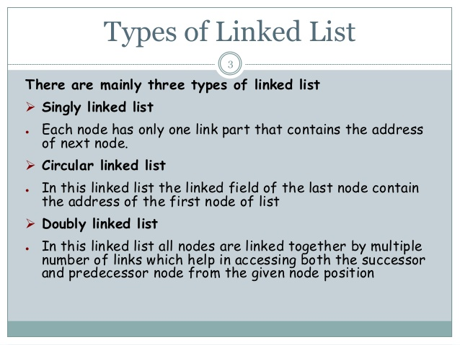

Slide 4
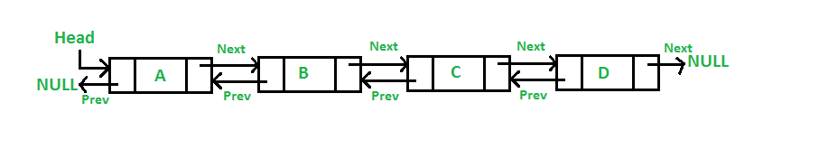
doubly linked list
A doubly linked list is a linked data structure that consists of a set of sequentially linked records called nodes.
Each node contains two fields, called links, that are references to the previous and to the next node in the sequence of nodes. and one data field.

Slide 5
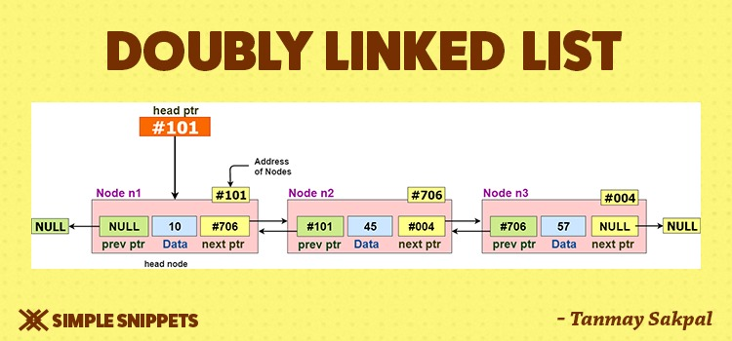
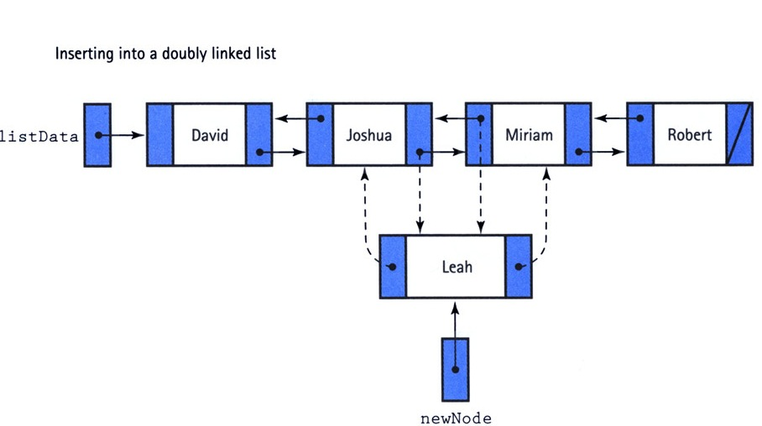

Slide 6
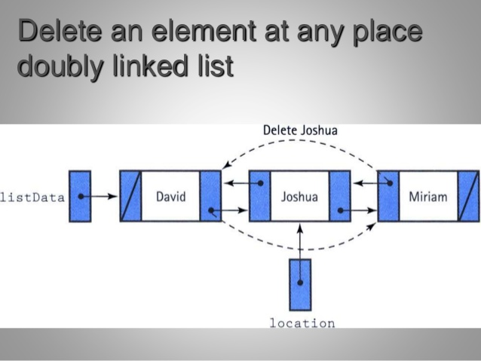

Slide 7
Basic Operations
Following are the basic operations supported by a list.
Insertion − Adds an element at the beginning of the list.
Deletion − Deletes an element at the beginning of the list.
Insert Last − Adds an element at the end of the list.
Delete Last − Deletes an element from the end of the list.
Insert After − Adds an element after an item of the list.
Delete − Deletes an element from the list using the key.
Display forward − Displays the complete list in a forward manner.
Display backward − Displays the complete list in a backward manner.

Slide 8
Advantages over singly linked list
1) A DLL can be traversed in both forward and backward direction.
2) The delete operation in DLL is more efficient if pointer to the node to be deleted is given.
Disadvantages over singly linked list
1) Every node of DLL Require extra space for an previous pointer. It is possible to implement DLL with single pointer though.
2) All operations require an extra pointer previous to be maintained. For example, in insertion, we need to modify previous pointers together with next pointers.

Slide 9
